Slide 1
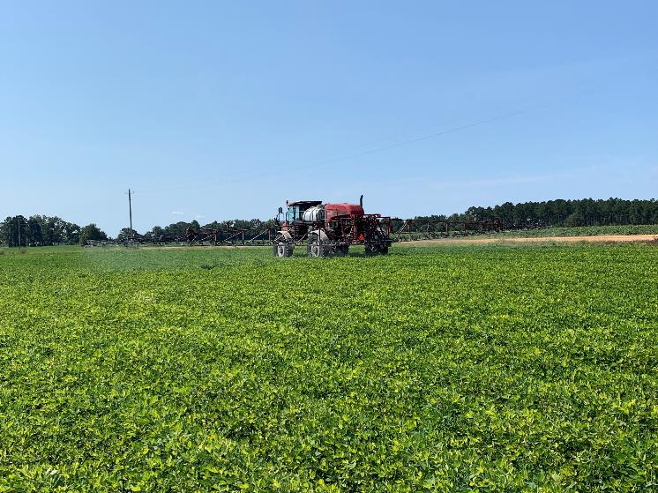

2025 Peanut Weed Control Update
Eric P. Prostko
Extension Weed Specialist
Dept. Crop & Soil Sciences

Slide 2
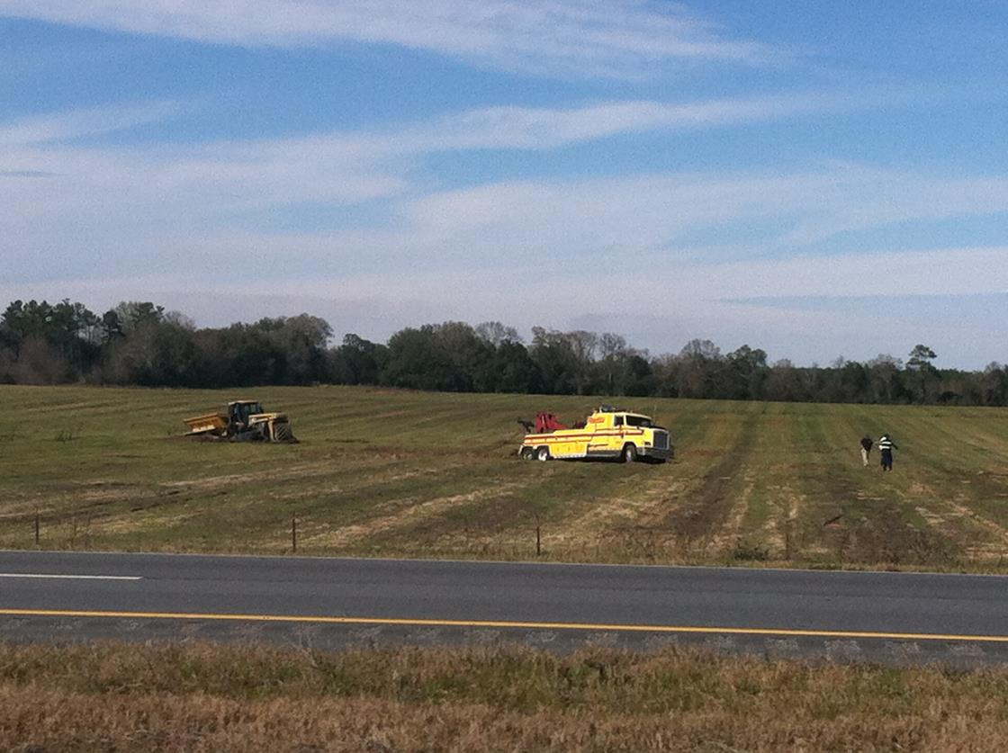
2024 Problems

Slide 3
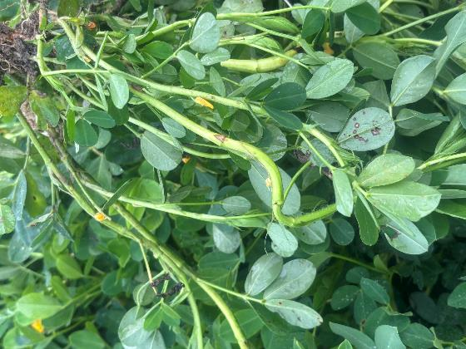
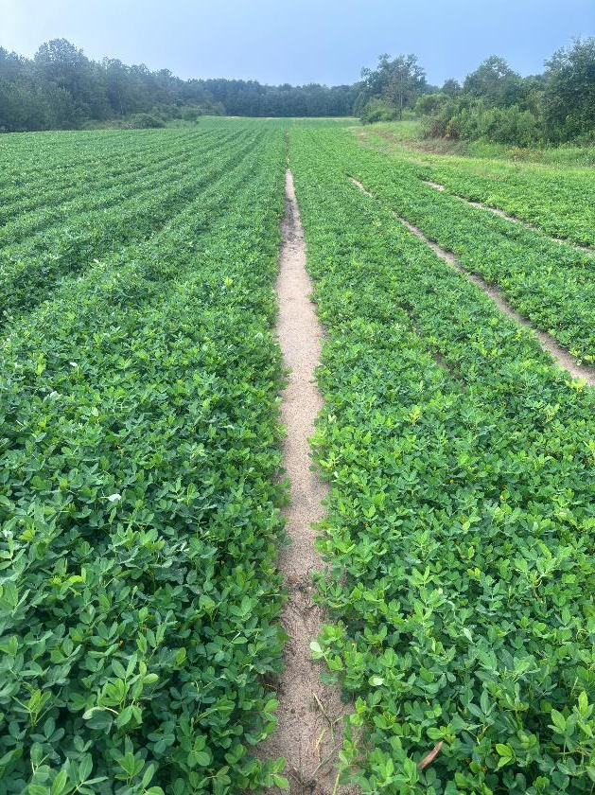
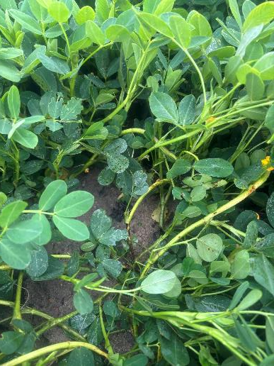
2,4-D LV4 @ 16 oz/A Applied at 45 DAP
Cadre
2,4-DB
Class Act NG
Cadre
2,4-D LV4
Class Act NG
13% yield loss??

Slide 4
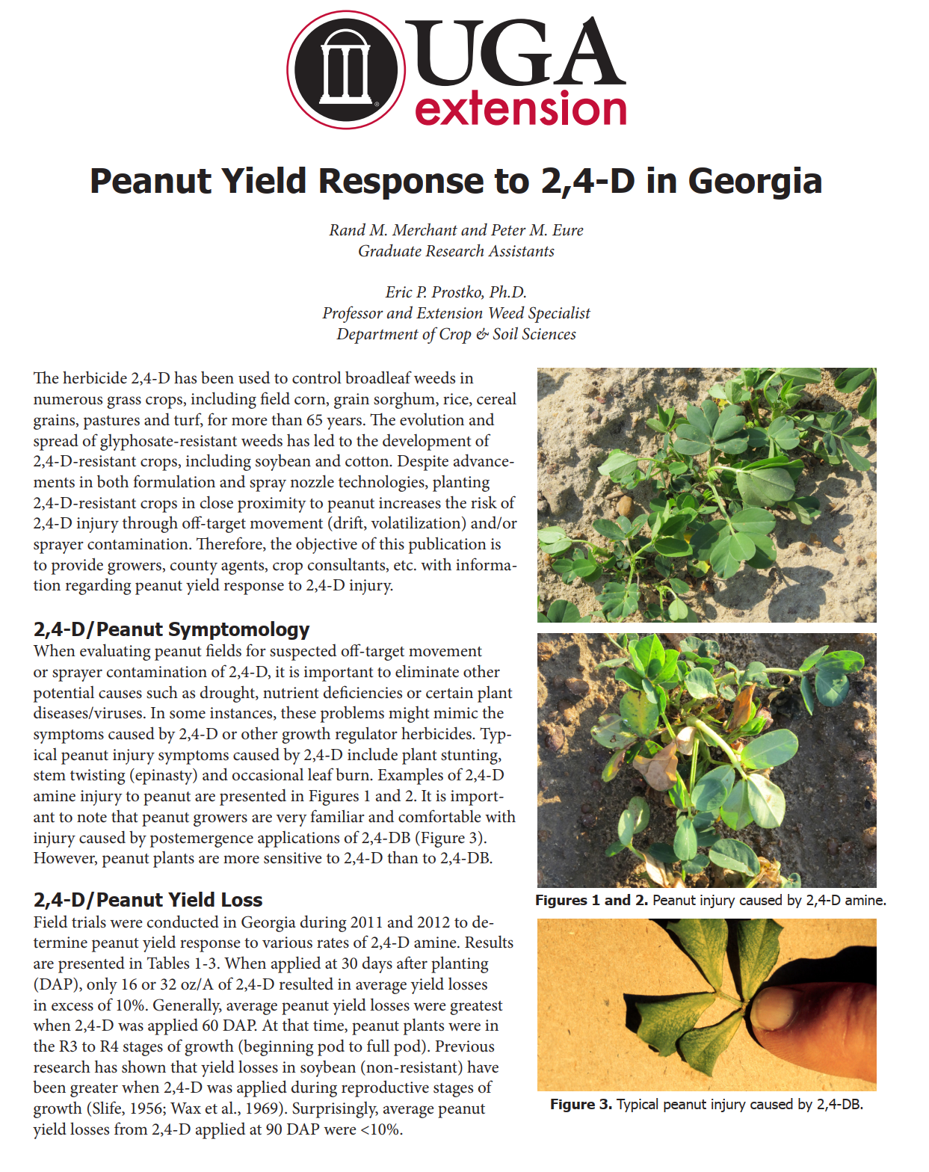
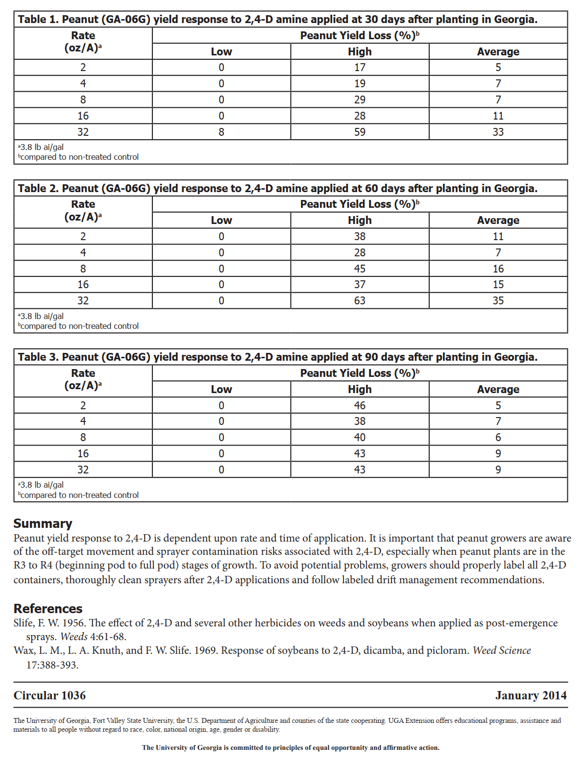
2,4-D (not 2,4-DB) on Peanut

Slide 5
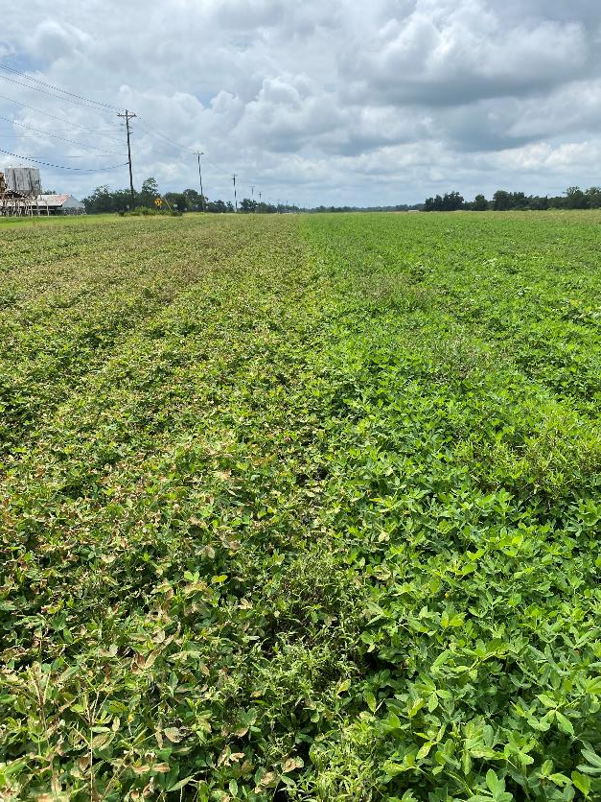
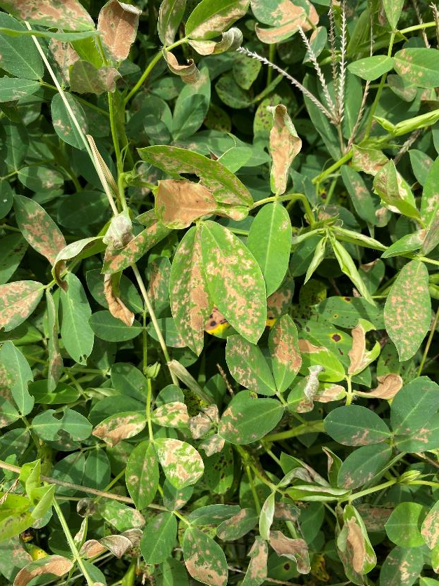
Gramoxone 3SL @ ~8-16 oz/A (70-80 DAP)
No Negative Yield Effects

Slide 6

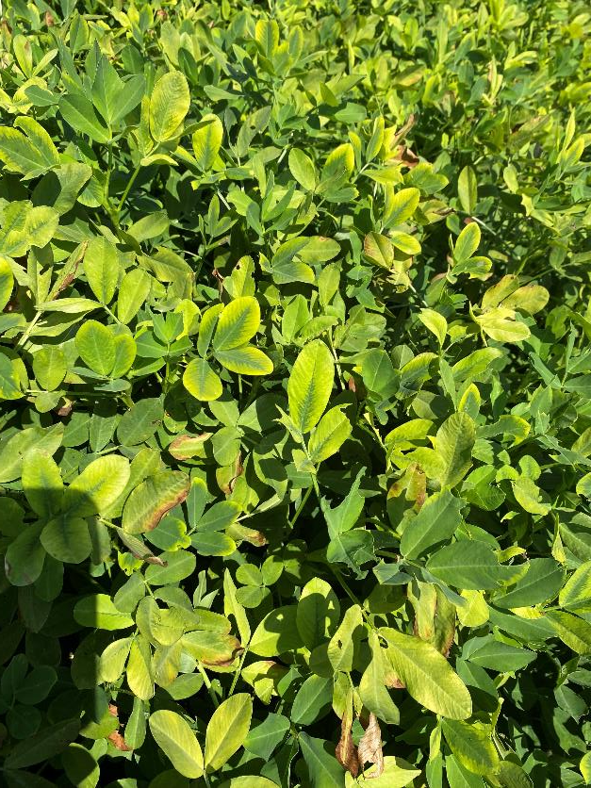
Atrazine 4L @ 12 oz/A ~90 DAP
~ 4500 NTC
~2500 treated
44% yield loss

Slide 7
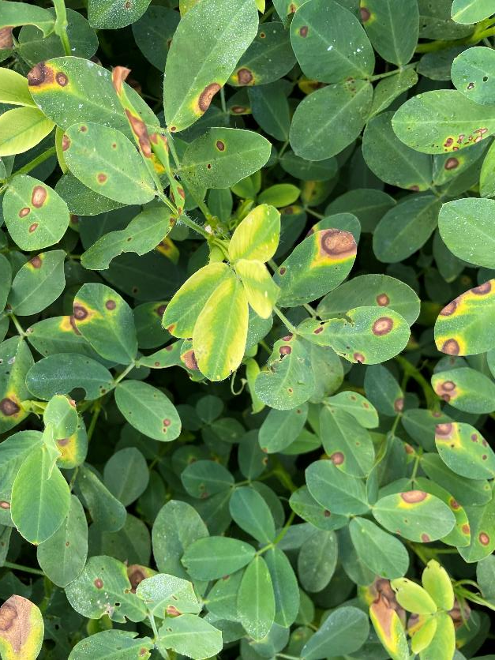
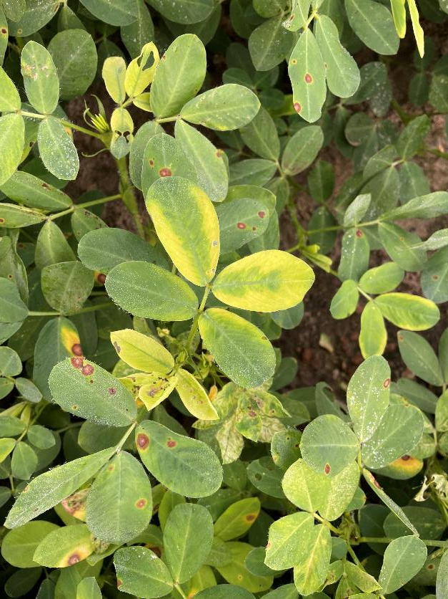
Roundup Drift on Peanut From Drone (3 qt/A + COC @ 3 GPA)

Slide 8
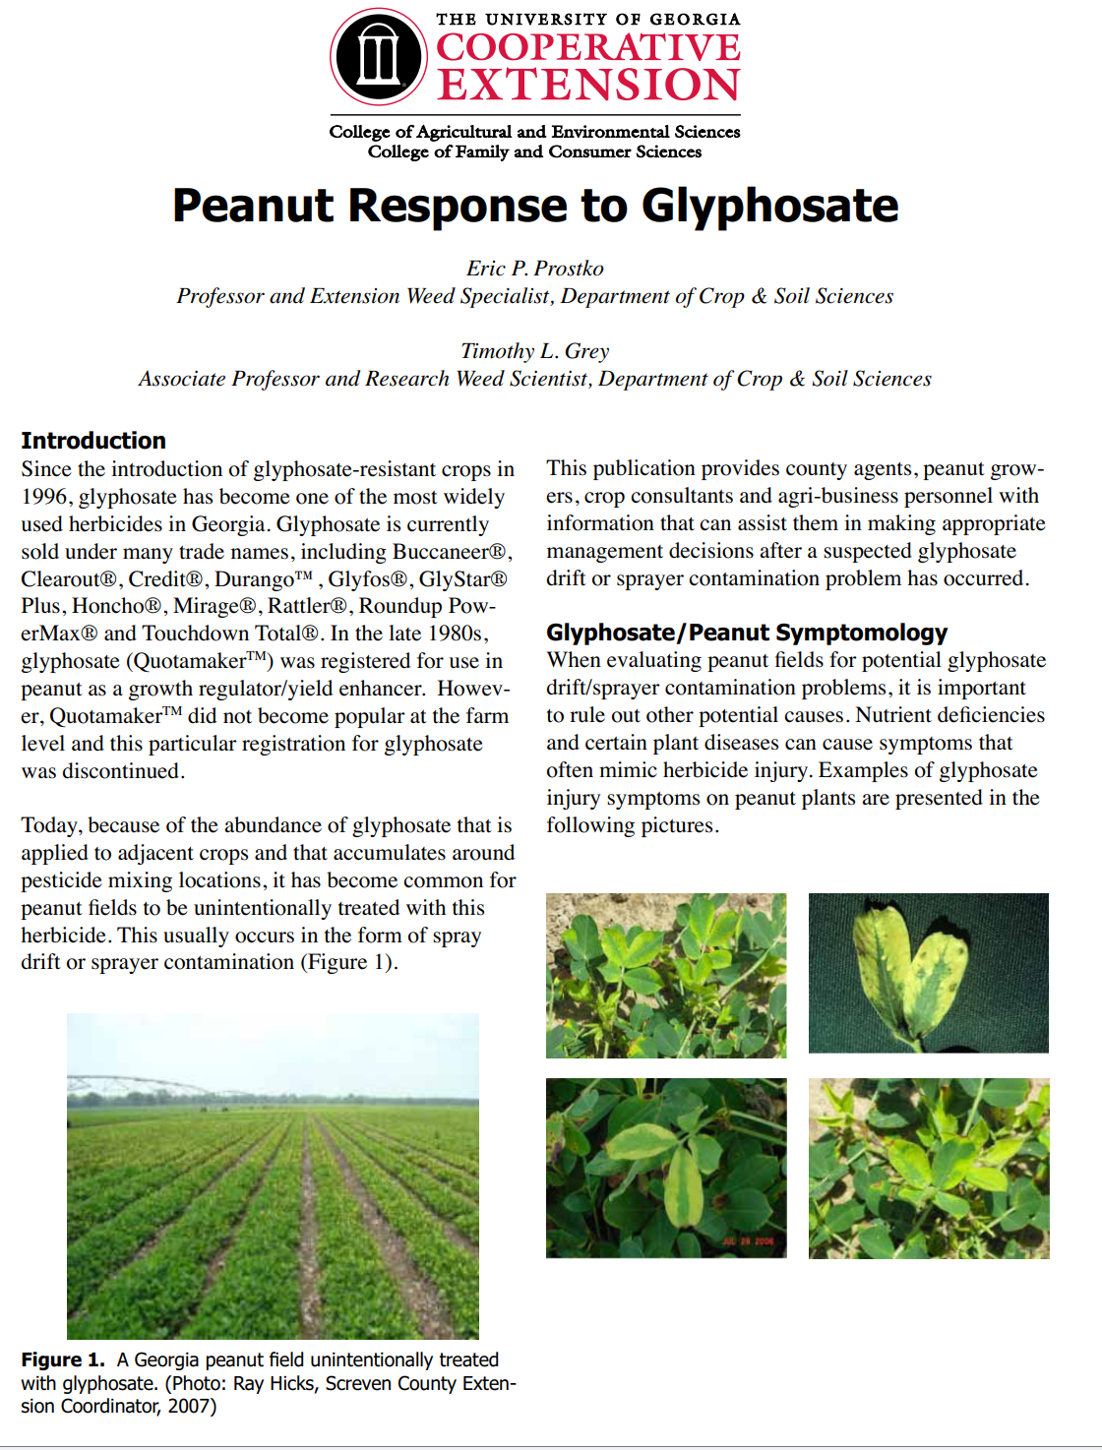
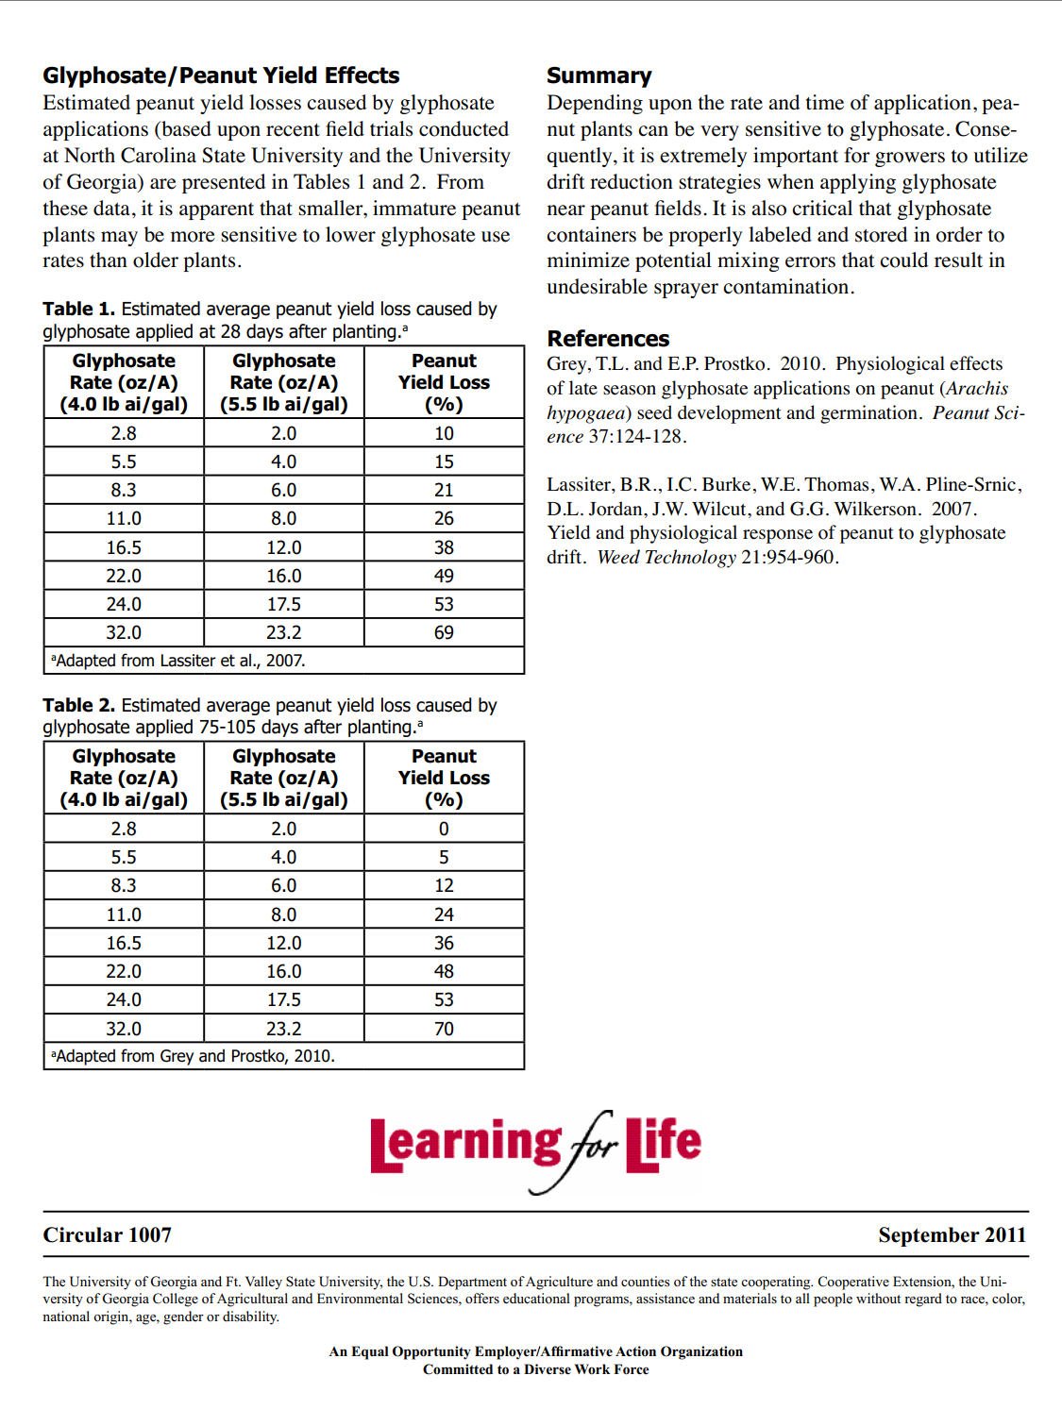
Roundup/Peanut

Slide 9
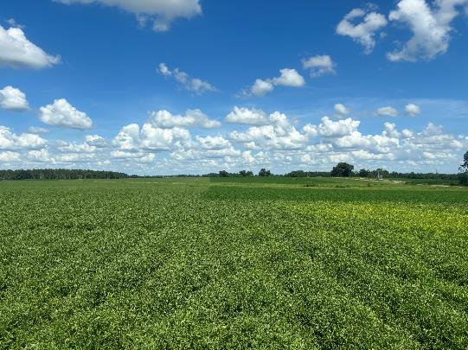
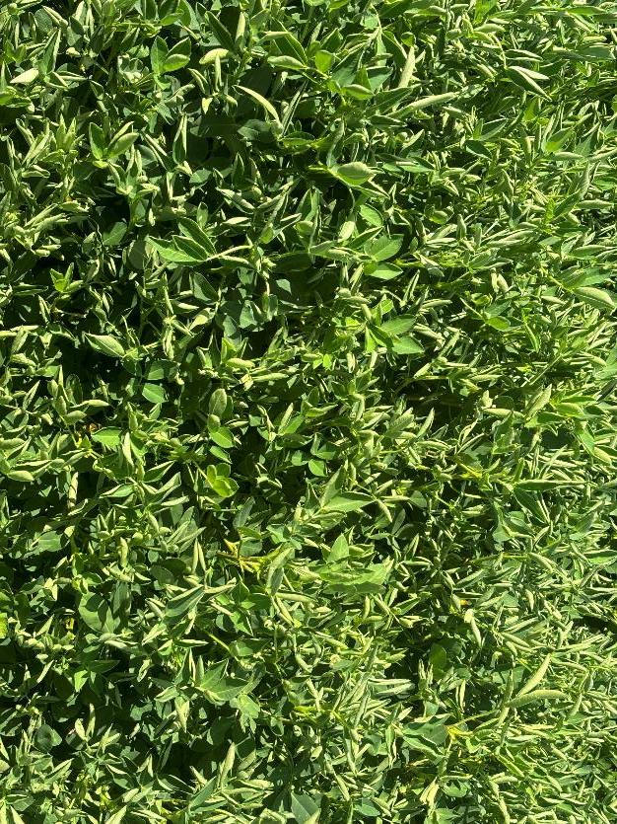
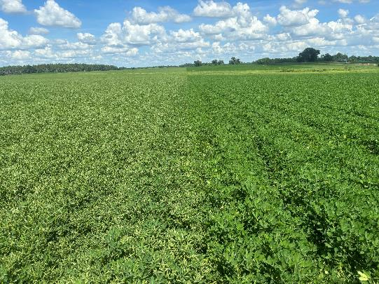
Gunslinger AMP (aminopyralid + 2,4-D) Sprayer Contamination (24 oz/A applied to pasture then rinsed out)
GA-12Y
60 DAP
July 22, 2024
21 DAT

Slide 10
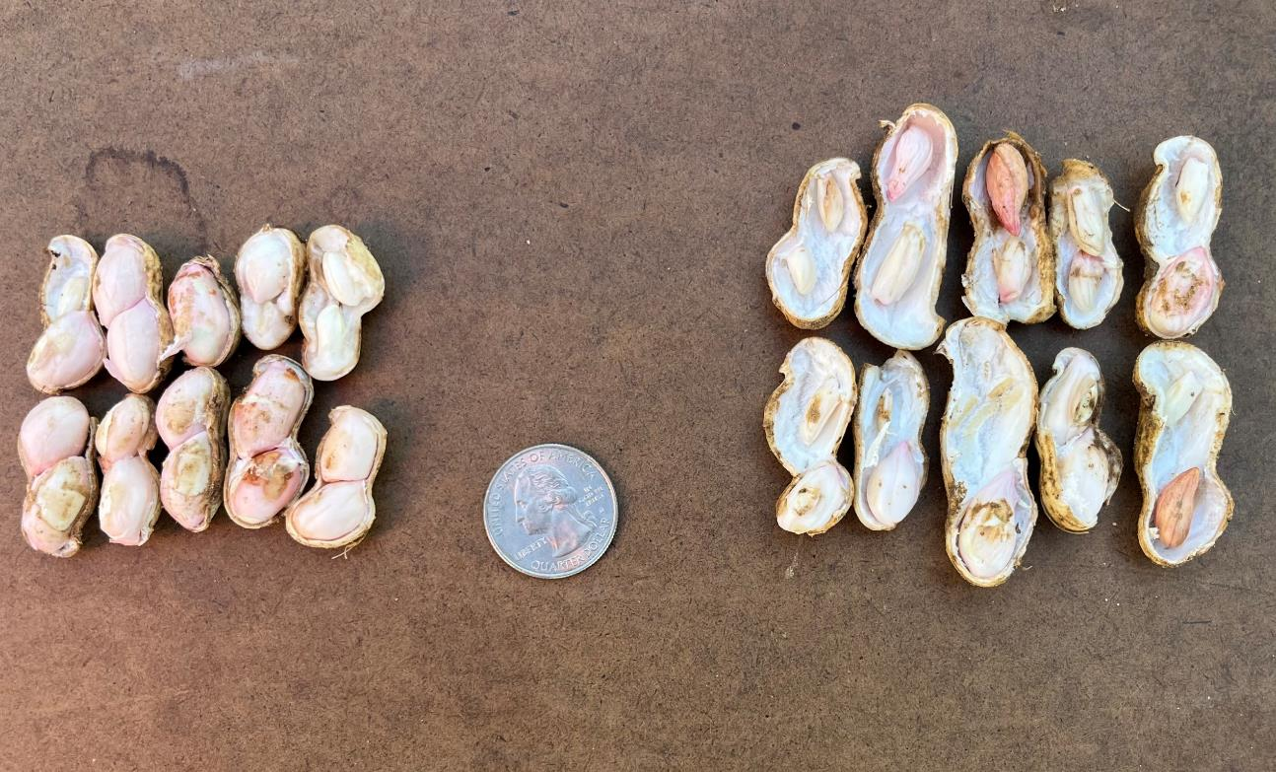
Gunslinger AMP (aminopyralid + 2,4-D) Sprayer Contamination (24 oz/A applied to pasture then rinsed out)
GA-12Y
60 DAP
Final Story
Treated = 5000 lbs/A (-8%)
68-72 grade
Non-Treated = 5400 lbs/A
1/100X rate based on 2024 data
NTC
Treated
August 20, 2024
50 DAT

Slide 11
Numerical Peanut Yield Loss (%) from “Non-Peanut” Herbicides Applied at 1/10X Rates at Different Times in Georgia

Slide 12
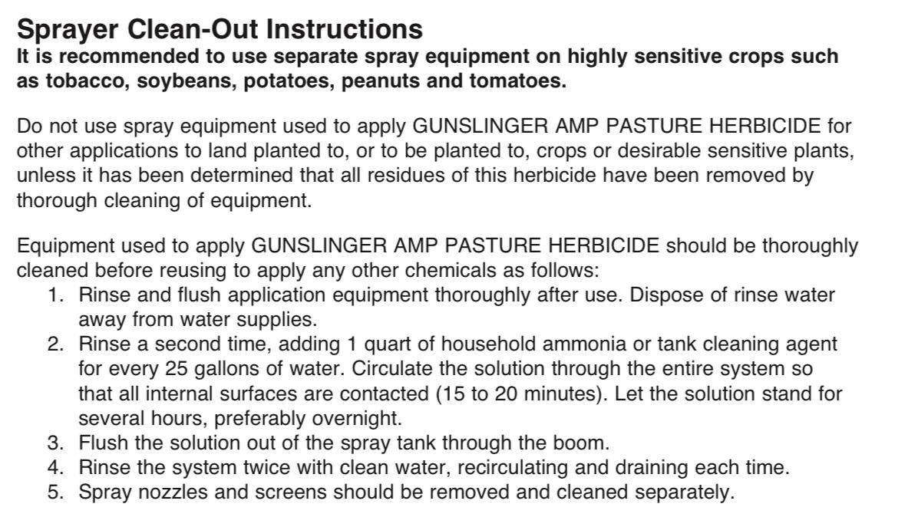
Gunslinger AMP Sprayer Cleanout

Slide 13
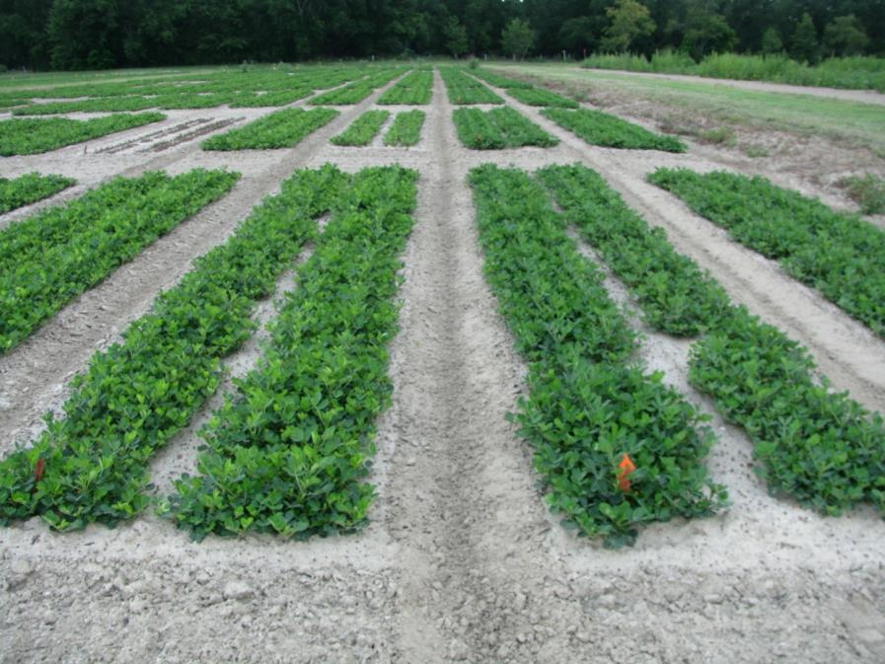
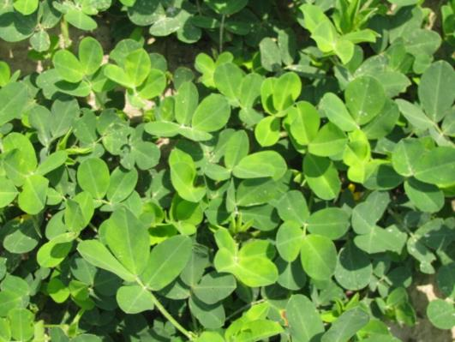
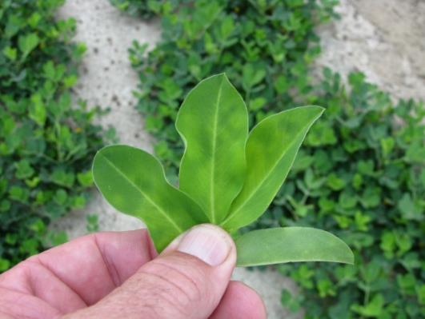
Cadre “Yellow Flash” – 3 DAT
TREATED
NTC
June 25, 2010
GA-06G

Slide 14
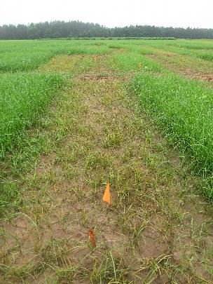
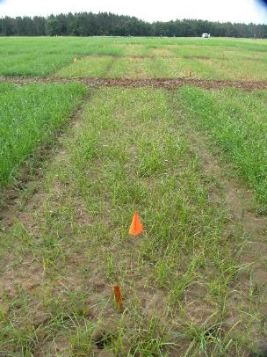
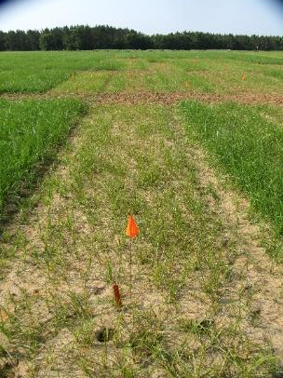
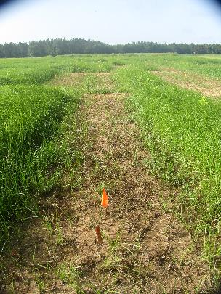
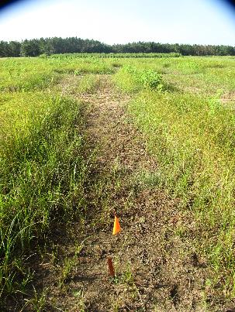
Yellow Nutsedge Control with Cadre @ 4 oz/A + Agridex @ 1% v/v - 2019
May 31
9 DAT
June 3
12 DAT
June 12
21 DAT
June 24
33 DAT
July 16
55 DAT
PE-17-19
Applied May 22 6-12” at application

Slide 15
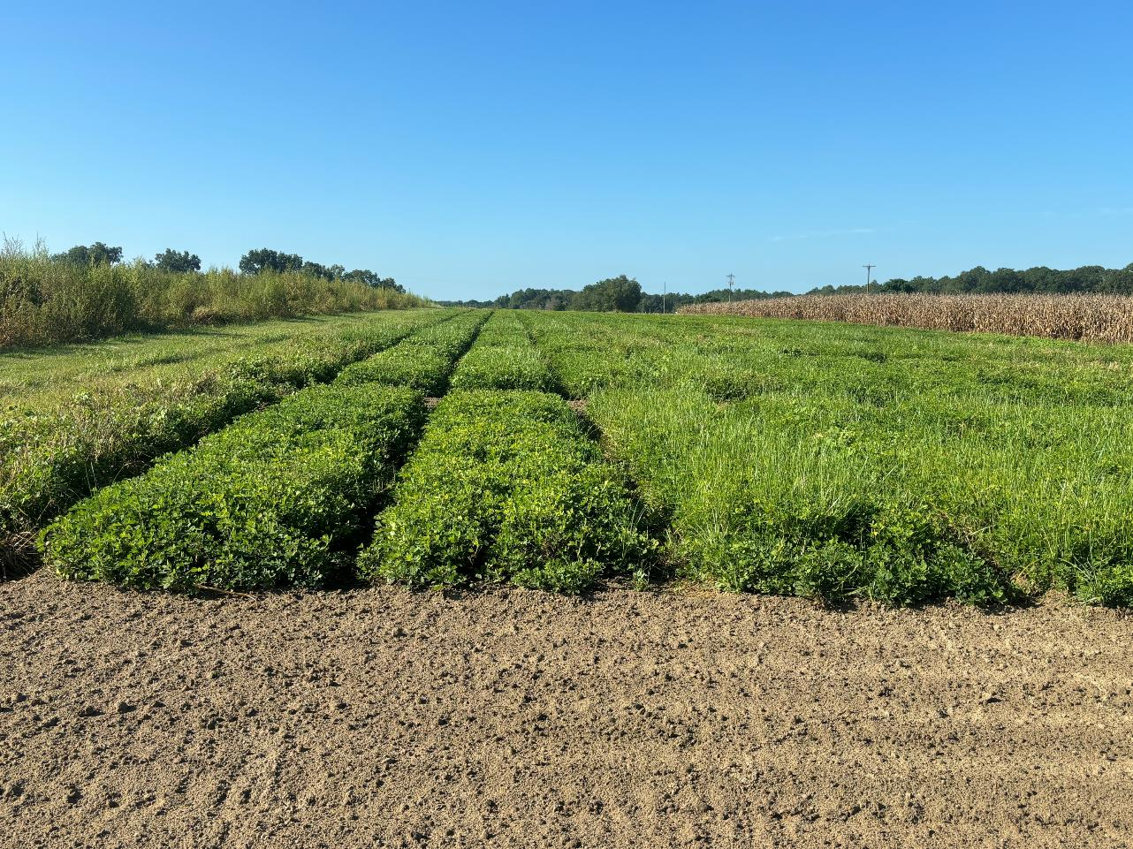
Cadre Not Working on Yellow Nutsedge Anymore?
Prowl H₂0 @ 32 oz/A
Valor EZ @ 3 oz/A
Strongarm @ 0.225 oz/A
(PRE)
Cadre @ 4 oz/A
Warrant @ 48 oz/A
Butyrac @ 16 oz/A
Agridex @ 1% v/v
(34 DAP)
Prowl H₂0 @ 32 oz/A
Valor EZ @ 3 oz/A
Strongarm @ 0.225 oz/A
(PRE)
Cadre @ 4 oz/A
Enversa @ 48 oz/A
Butyrac @ 16 oz/A
Agridex @ 1% v/v
(34 DAP)
Prowl H₂0 @ 32 oz/A
Valor EZ @ 3 oz/A
Strongarm @ 0.225 oz/A
(PRE)
Cobra @ 12.5 oz/A
Warrant @ 48 oz/A
Butyrac @ 16 oz/A
Agridex @ 1% v/v
(34 DAP)
PE-16-23
August 29
120 DAP

Slide 16
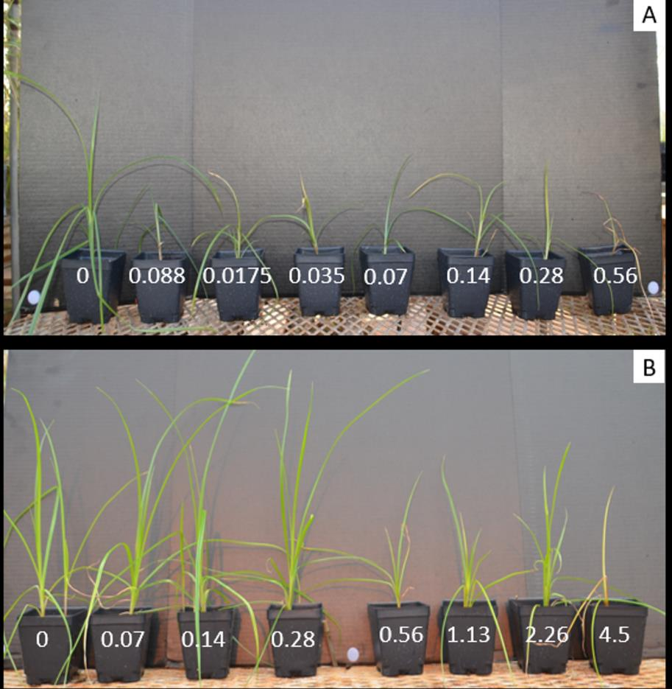
Cadre (imazapic) Resistant Yellow Nutsedge – 28 DAT
Sensitive
Cadre 2AS @ 4 oz/A
(0.07 kg ai/ha)
Resistant

Slide 17
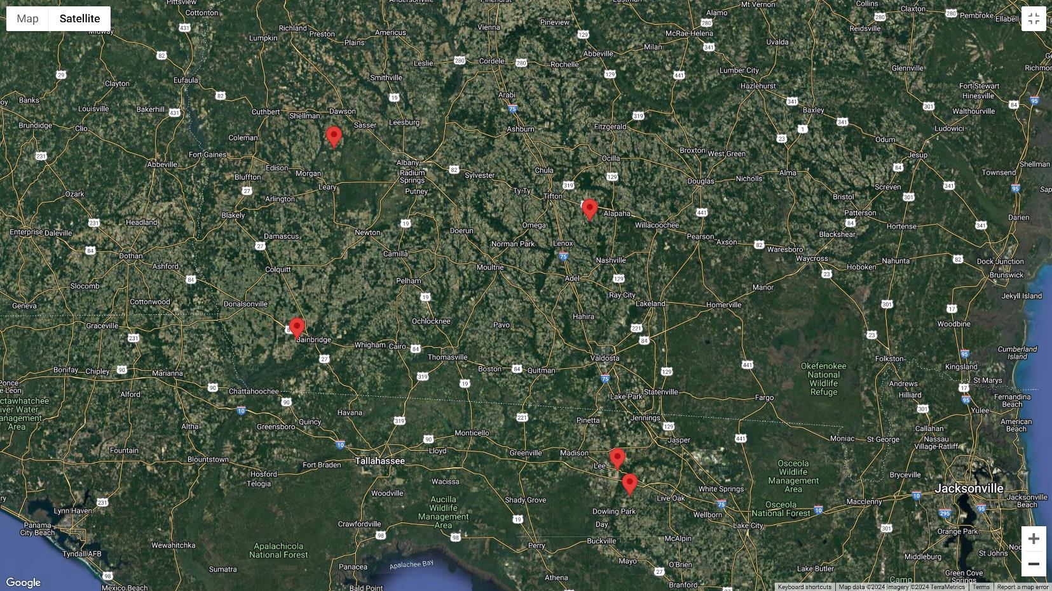



Yellow Nutsedge/Cadre Samples-2024

Slide 18
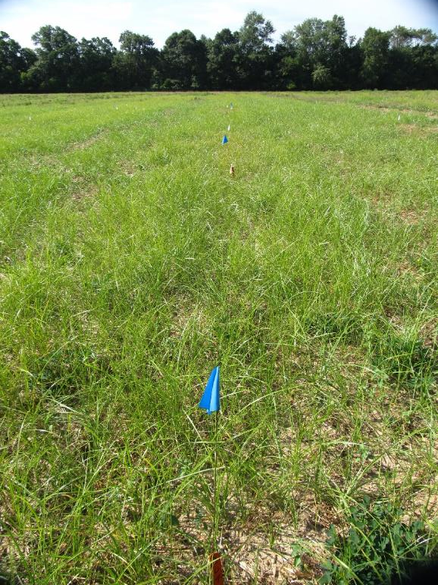
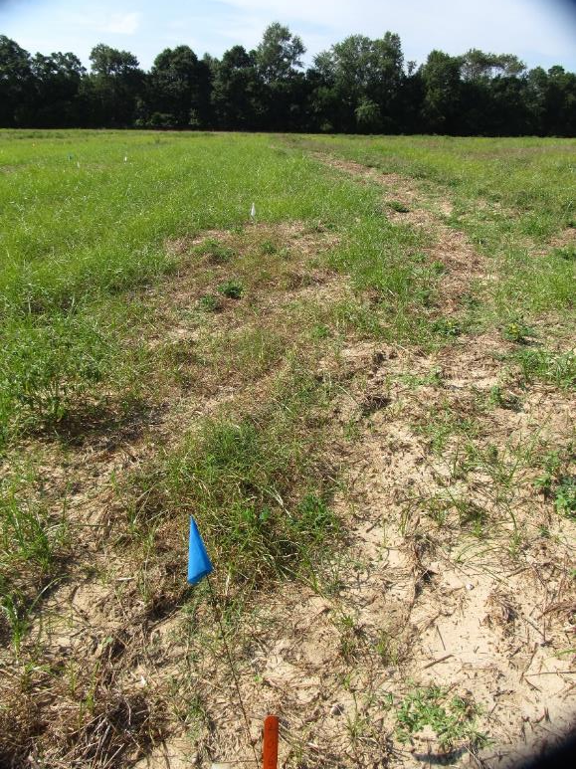
Yellow Nutsedge Control with Broadloom (bentazon) - 2019
NTC
Broadloom 4SL @ 32 oz/A
Agridex @ 1% v/v
2 POST applications 10 days apart
NC-04-19
August 7
13 days after POST2

Slide 19
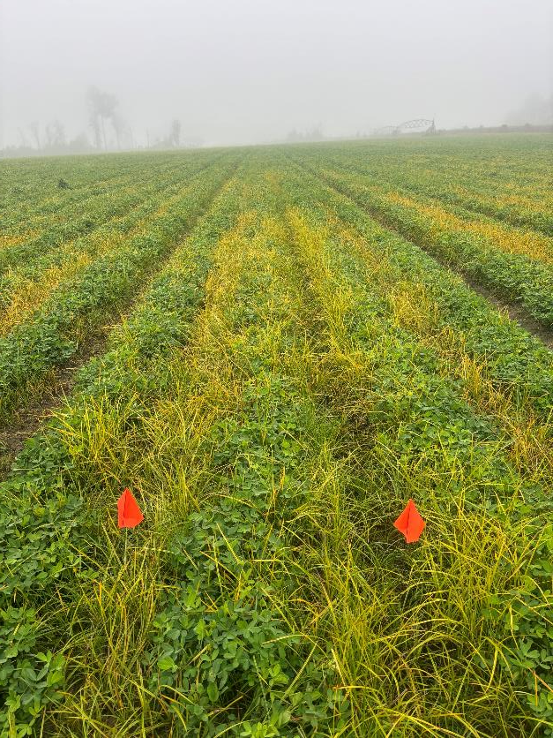
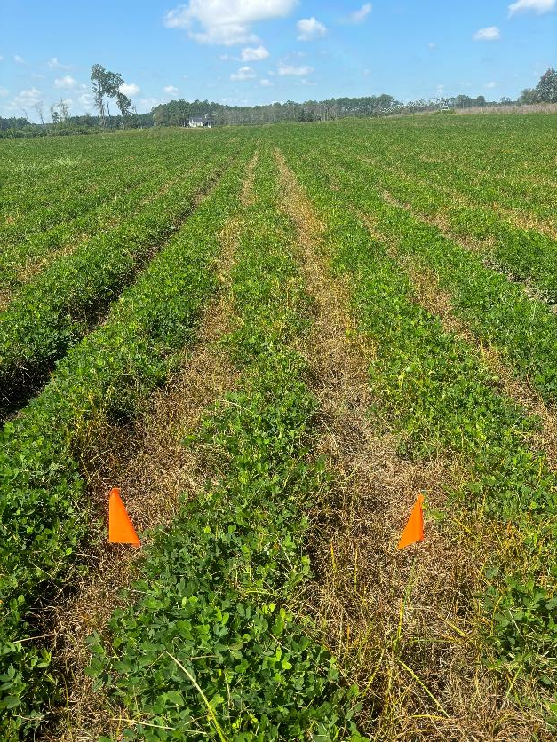
Yellow Nutsedge Control with Split Shot of Basagran (32 oz/A) + Crop Oil (1% v/v) – Field was previously treated with Cadre @ ~40 DAP. (Basagran + COC was applied August 30 then September 10)
Berrien Co. (2024)
08/27/24 - Before
09/17/24 - After

Slide 20
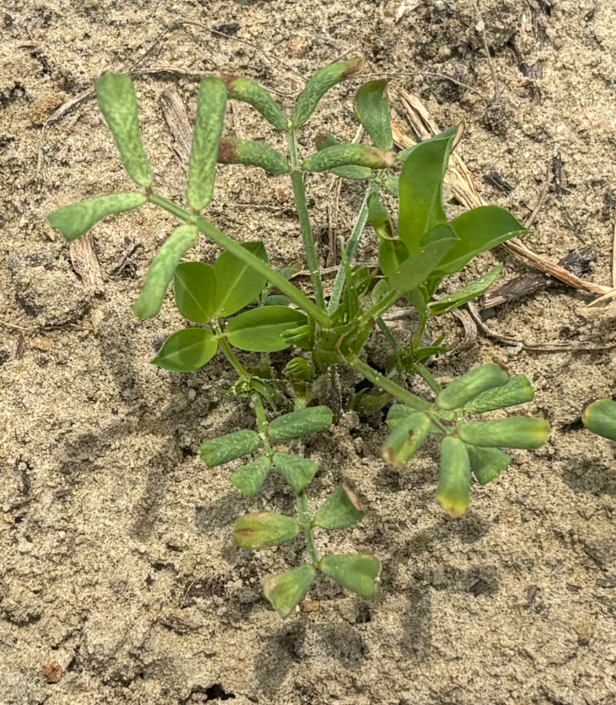
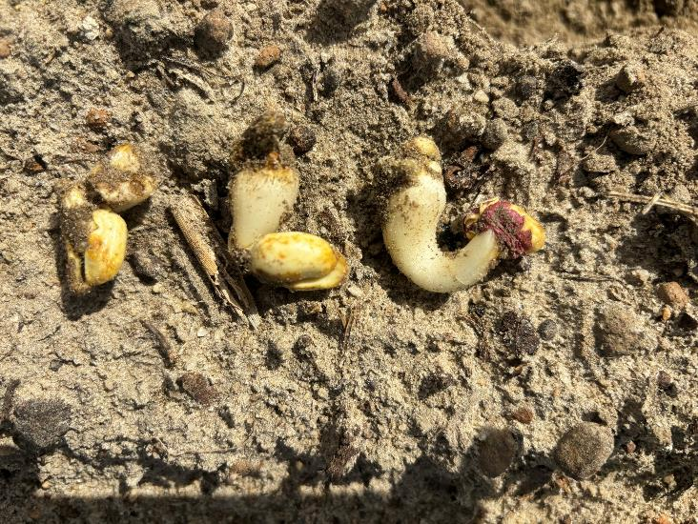
Dicamba Preplant? NO, NO, NO!!!!
C. Jones
Birdsong Peanuts
June 2024

Slide 21
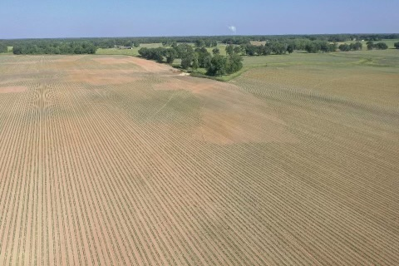
Dicamba Preplant in Peanut (Not Labeled, need at least 28 D + 1” rainfall/irrigation)
W. Briggs
06/14/24

Slide 22
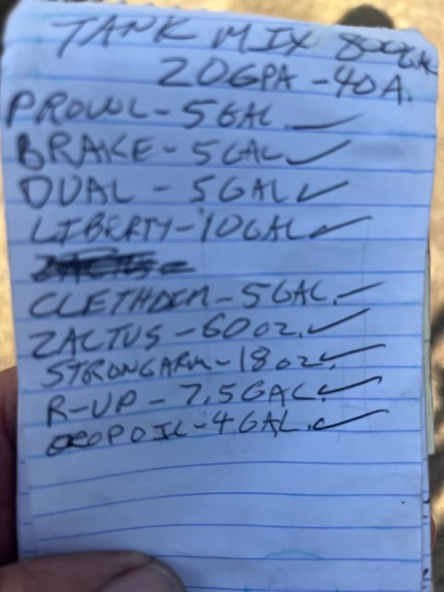
Do What?
Prowl @ 16 oz/A ($5.88)
Brake @ 16 oz/A ($23.23)
Dual @ 16 oz/A ($8.88)
Liberty @ 32 oz/A ($6.00)
Clethodim @ 16 oz/A ($6.88)
Zaltus @ 1.5 oz/A ($3.47)
Strongarm @ 0.45 oz/A ($20.18)
Roundup @ 24 oz/A ($4.03)
Crop Oil @ 12.8 oz/A ($2.00)
Total Cost/A = ~$80.55
C.A. Abbott
SePro
May 8, 2024
VA Grower

Slide 23
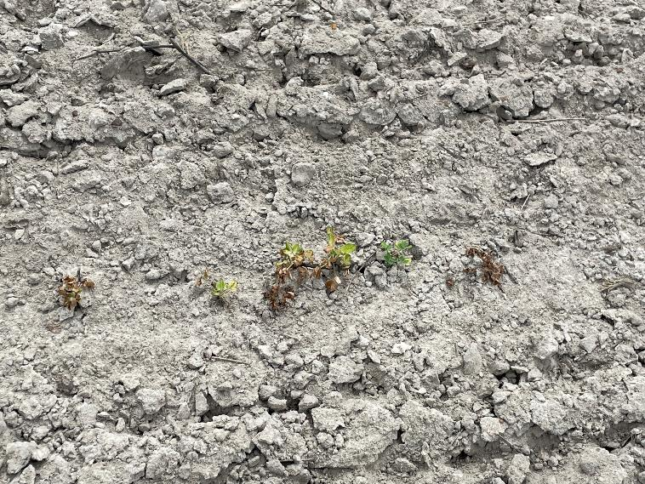
Peanut/pH/Zinc
Examples:
Waters: 1) Good: pH = 6.2, Zn = 8.4 lbs/A; Bad: pH = 5.4, Zn = 5.8 lbs/A
Riden: 1) Good: pH = 5.9, Zn = 9.9 lbs/A; Bad: pH = 5.0, Zn = 5.0 lbs/A
Berrien Co.
2024

Slide 24
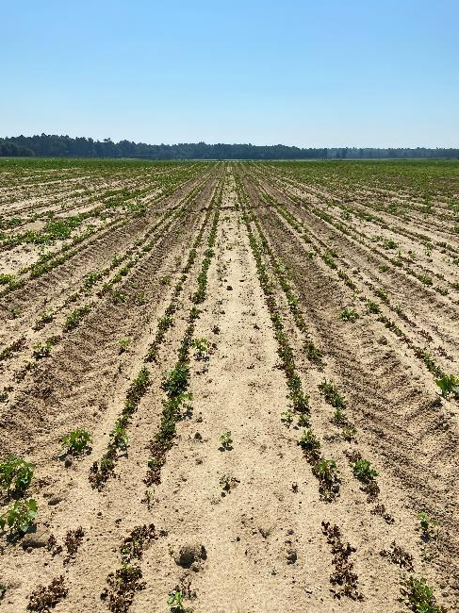
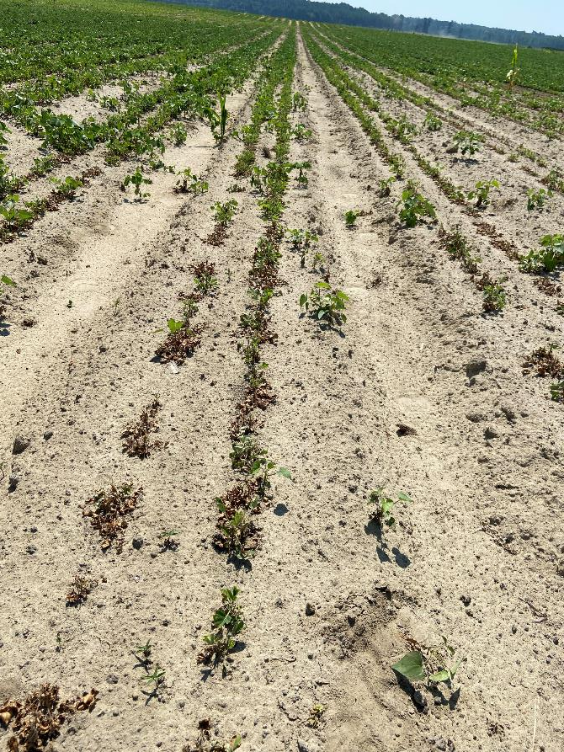
Peanut/pH/Zn
Good: pH = 5.8; Zn = 3 lbs/A
Bad: pH = 4.6; Zn = 108 lbs/A
Burke Co.
July 2024

Slide 25
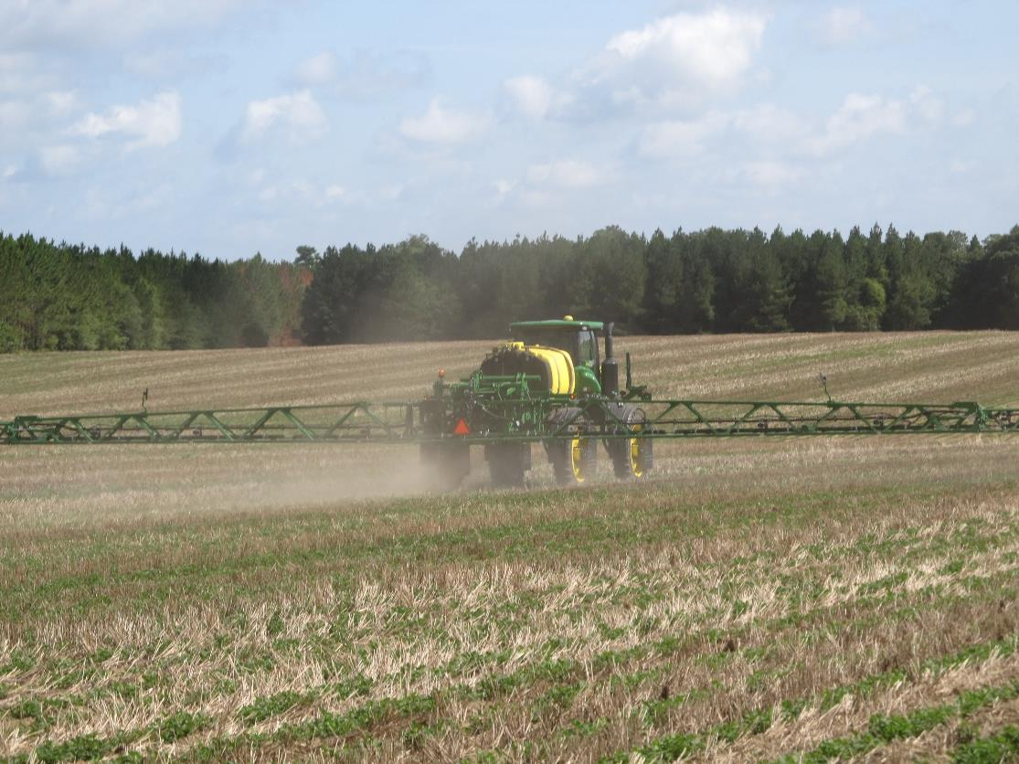
Peanut Weed Control Programs

Slide 26
Herbicide Use in Georgia Peanuts (2018 and 2023)
Sources: USDA/NASS: 2018 Agrichemical Use Survey-Peanut, May 2019, No. 2019-2; 2023 Agrichemical Use Survey-Peanut, May 2024, No. 2024-3.

Slide 27
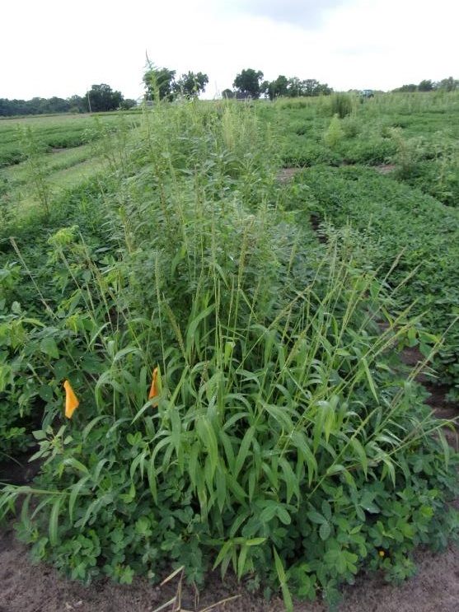
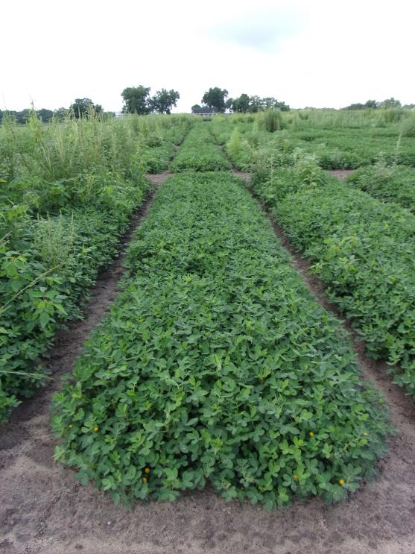
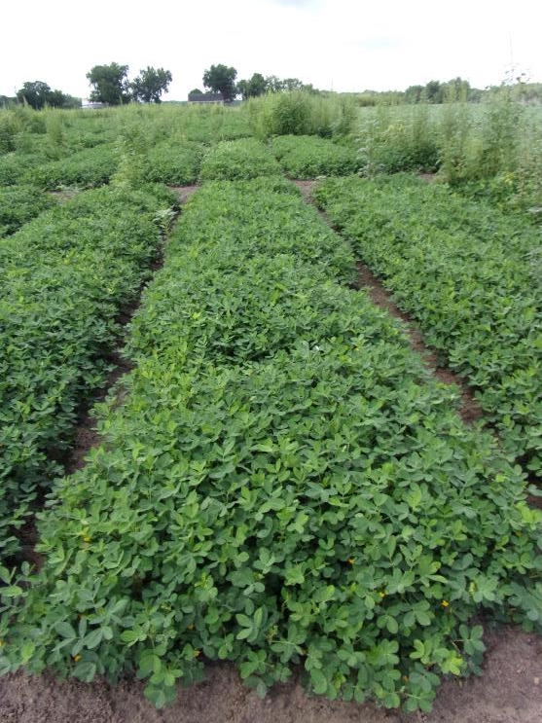
Peanut Weed Control - 2024
4646 lbs/A
4681 lbs/A
Prowl H₂0 3.8SC @ 32 oz/A
Valor EZ 4SC @ 3 oz/A
Strongarm 84WG @ 0.225 oz/A
PRE (1 DAP)
Cadre 2AS @ 4 oz/A
Butyrac 200 2SL @ 16 oz/A
Dual Magnum 7.62EC @ 16 oz/A
POST (34 DAP)
Sonalan 3EC @ 32 oz/A
Valor EZ 4SC @ 3 oz/A
Strongarm 84WG @ 0.225 oz/A
PRE (1 DAP)
Cadre 2AS @ 4 oz/A
Butyrac 200 2SL @ 16 oz/A
Dual Magnum 7.62EC @ 16 oz/A
POST (34 DAP)xxx
NTC
PE-07-24
July 22
83 DAP

Slide 28
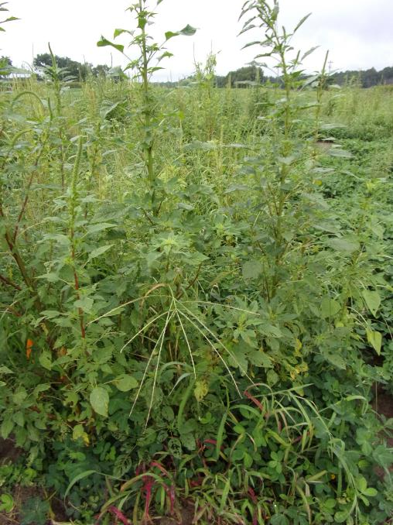
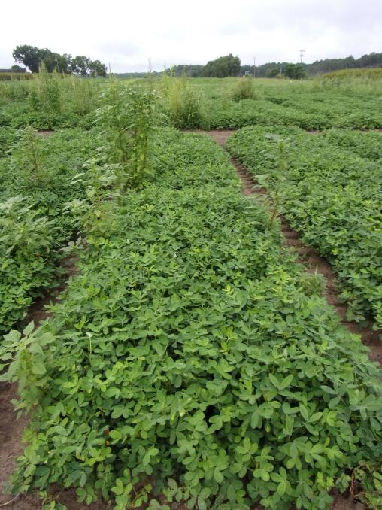
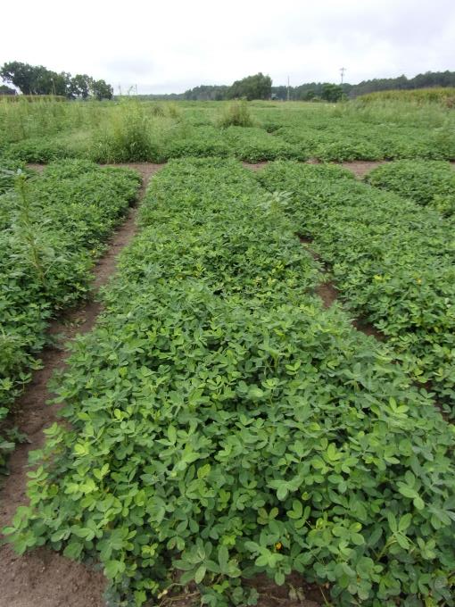
Peanut Weed Control - 2024
4024 lbs/A
4123 lbs/A
NTC
Gramoxone 3SL @ 8 oz/A
Basagran 5L @ 6.4 oz/A
Dual Magnum 7.62EC @ 16 oz/A
EPOST (12 DAP)
Cadre 2AS @ 4 oz/A
Butyrac 200 2SL @ 16 oz/A
Dual Magnum 7.62EC @ 16 oz/A
POST (34 DAP)
Gramoxone 3SL @ 8 oz/A
Bastante 4SL @ 8 oz/A
Dual Magnum 7.62EC @ 16 oz/A
EPOST (12 DAP)
Actylis (imazapic) 2AS @ 4 oz/A
Actylis (2,4-DB) 2SL @ 16 oz/A
Dual Magnum 7.62EC @ 16 oz/A
POST (34 DAP)
PE-18-24
July 22
82 DAP

Slide 29





WSSA Group 15 Herbicides?

Slide 30
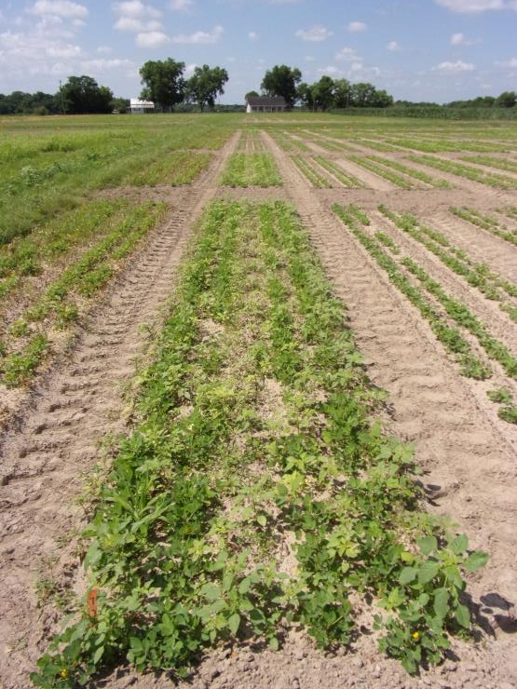
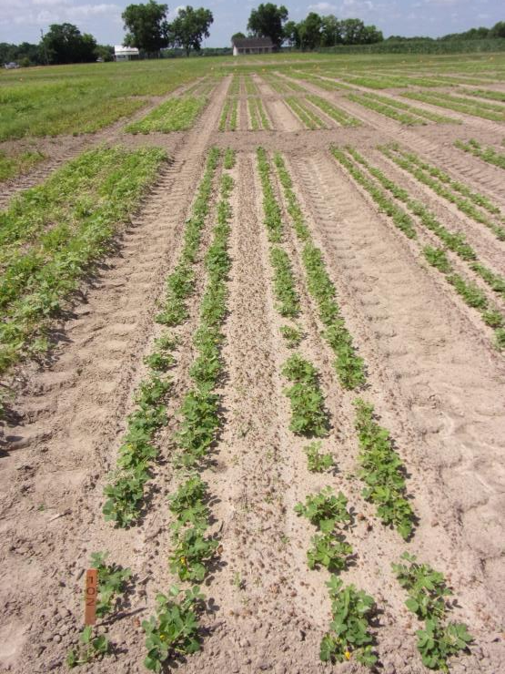

Storm vs. “Georgia” Storm - 2024
NTC
Gramoxone 3SL @ 8 oz/A
Storm 4SL @ 16 oz/A
Dual Magnum 7.62EC @ 16 oz/A
Gramoxone 3SL @ 8 oz/A
Ultra Blazer 2LC @ 16 oz/A
Broadloom 4LC @ 8 oz/A
Dual Magnum 7.62EC @ 16 oz/A
PE-10-24
June 3
21 DAT

Slide 31




Peanut Weed Control - 2024 Cadre/Ultra Blazer/Cobra/2,4-DB/Dual Magnum Tank-Mixes (15 GPA, AIXR11002 Tips)
NTC
Cadre 2AS @ 4 oz/A
Butyrac 200 2SL @ 16 oz/A
Dual Magnum 7.62EC @ 16 oz/A
Cadre 2AS @ 4 oz/A
Cobra 2EC @ 12.5 oz/A
Butyrac 200 2SL @ 16 oz/A
Dual Magnum 7.62EC @ 16 oz/A
Cadre 2AS @ 4 oz/A
Ultra Blazer 2SL @ 24 oz/A
Butyrac 200 2SL @ 16 oz/A
Dual Magnum 7.62EC @ 16 oz/A
PE-20-24
July 22
61 DAT

Slide 32



Valor Injury - 2019
NTC
3 oz/A
6 oz/A
PE-07-19
May 14
13 DAP

Slide 33
Valor Effects on Peanut Yield High Moisture Conditions - 2019
lbs/A
PE-07-19
- Weed-free
- 8.3” rainfall/irrigation
first 30 DAP
*averaged over 4 Dual Magnum rates
P = 0.7798
CV = 10.6

Slide 34


Valor causes injury but what about weed control?
Dryland
Valor + Prowl
Timely rain after application
Old Age or “Natties”
D. Hall
June 4, 2024

Slide 35
Peanut Yield as Influenced By Valor 50WG (3 oz/A) Timing (Only Valor + Water was Applied at Listed Timings)
Prowl PPI @ 2.4 ptA
Irrigation:
1 DAP = 0.50” irrigation
8 DAP = 0.65” irrigation
13 DAP = 0.50” irrigation
Historic Rainfall Avg. (May 8-29)
21 DAP
2.44”
21%-67% yield loss!
“True Crack”
lbs/A
2” tall
3 leaf
PE-16-01
GA Green
Planted May 8, 2001
Time (DAP)
LSD 0.05 = 729
CV = 14.33

Slide 36


New Stuff
Where’s Bob?

Slide 37


Generic Strongarm?
Aceto/Actylis
Only 2 years of field data?
25 years with Strongarm
Cheaper than brand name?
No problems thus far.
Label has expanded POST section.

Slide 38



Peanut Weed Control - 2024
4215 lbs/A
4271 lbs/A
NTC
Sonalan 3EC @ 32 oz/A
Valor EZ @ 4SC @ 3 oz/A
Strongarm 84WG @ 0.225 oz/A
PRE
Cadre 2AS @ 4oz/A
Butyrac 200 2SL @ 16 oz/A
Dual Magnum 7.62EC @ 16 oz/A
POST (34 DAP)
Actylis (ethalfluralin) 3EC @ 32 oz/A
Valor EZ @ 4SC @ 3 oz/A
Diclom 84WG @ 0.225 oz/A
PRE
Actylis (imazapic) 2AS @ 4oz/A
Actylis (2,4-DB) 2SL @ 16 oz/A
Dual Magnum 7.62EC @ 16 oz/A
POST (34 DAP)
PE-18-24
July 22
82 DAP

Slide 39



Brake Injury – 2024 (Grower Field) GA-18RU (Planted April 25); Brake @ 12 oz/A + Dual Magnum @ 22 oz/A (April 27)
T. Price
Cook Co.
May 17

Slide 40

Brake Label Issues
“Apply prior to planting or within 36 hours after planting”
Equipment issues?
Weather?

Slide 41




2024 Brake/Rexovor Timing Study
1 DAP
3 DAP
7 DAP
5 DAP
PE-02-24

Slide 42



Brake/Rexovor Timing – 2024 Brake 1.2SC @ 12 oz/A
PE-08-24
May 13
12 DAP
NTC
5 DAP
7 DAP

Slide 43
Peanut (GA-06G) Yield Response to Brake Timing (2022-2024)
Yield (lbs/A)
P = 0.63

Slide 44


Pendimethalin Formulations
Pendalin H₂0

Slide 45




Weed Control in Peanut with Different Pendimethalin Formulations - 2024
NTC
Prowl H₂0 3.8SC @ 32 oz/A
Valor EZ 4SC @ 3 oz/A
Strongarm 84WG @ 0.225 oz/A
PRE
Pendalin H₂0 3.8SC @ 32 oz/A
Valor EZ 4SC @ 3 oz/A
Strongarm 84WG @ 0.225 oz/A
PRE
Satellite Hydrocap 3.8SC @ 32 oz/A
Valor EZ 4SC @ 3 oz/A
Strongarm 84WG @ 0.225 oz/A
PRE
PE-01-24
June 11
41 DAT

Slide 46

Enversa™
Corteva
Ecapsulated acetochlor
Similar to but NOT the same as Warrant
Moisture activation issues?
Delay irrigation for 48 hours
Only 1 year of data for me

Slide 47



Weed Control in Peanut - 2024
0 DAT = 0.5” I
2 DAT = 0.9” R
7 DAT = 0.75”R
8 DAT = 0.75” R
11 DAT = 1.1” R
NTC
Warrant 3ME @ 48 oz/A
PRE
Enversa 3ME @ 48 oz/A
PRE
PE-16-24
June 14
44 DAP

Slide 48



Weed Control in Peanut - 2024
Prowl H₂0 3.8SC @ 32 oz/A
Valor EZ 4SC @ 3 oz/A
PRE
Cadre 2AS @ 4 oz/A
Butyrac 200 2SL @ 16 oz/A
Warrant 3ME @ 48 oz/A
Agridex @ 1% v/v
POST (34 DAP)
Prowl H₂0 3.8SC @ 32 oz/A
Valor EZ 4SC @ 3 oz/A
PRE
Cadre 2AS @ 4 oz/A
Butyrac 200 2SL @ 16 oz/A
Enversa 3ME @ 48 oz/A
Agridex @ 1% v/v
POST (34 DAP)
NTC
PE-16-24
July 22
82 DAP

Slide 49


What do the top Georgia peanut growers do? 2023 Georgia Peanut Achievement Club Winners
16 growers
142 to 1473 acres (range)
~520 acres (average)
5734 lb/A average yield
4630-6357 lbs/A (range)
2023 GA State Avg. = 4080 lb/A
100% - irrigated
56% - bottom plow
75% - twin rows
Herbicides
40% - Sonalan
93% - Valor
53% - Dual
73% - Cadre
47% - 2,4-DB
33% - Prowl
33% - Strongarm
13% - Zidua
13% - paraquat
20% - Storm

Slide 50

Questions/Comments

